Slide 1

Early Insights from Textual Data
Week - 2
Nikshep A Kulli

Slide 2
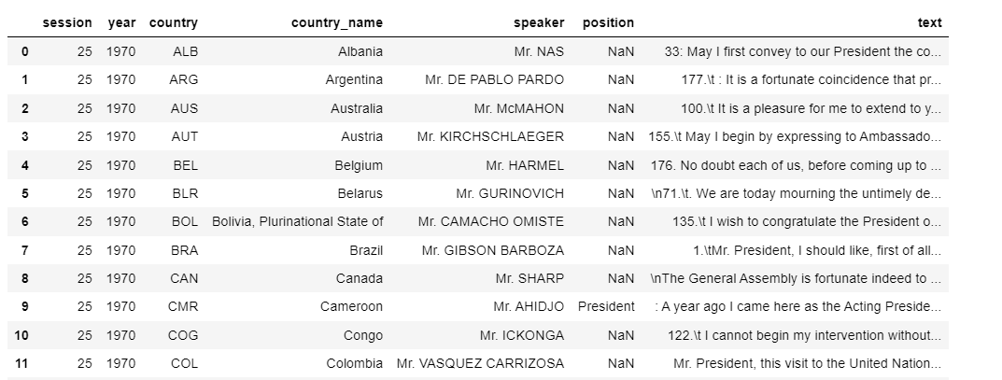
Today’s Dataset:
Speeches from the UN general assembly 1970 to 2016
Available from Kaggle.com (free)
Medium size: 7 columns, 7507 long speeches
Columns: Session, year, country, country_name, speaker, position, text

Slide 3
Open the file!:
import pandas as pd
file = “Relativefile path"
df = pd.read_csv(file)
df.head(20)
This is the full path name of the file.
Notice the direction of the /
Show the first 20 records

Slide 4
Lets start with an overview:
df.columns
df.dtypes
df.info()
df.describe()

Slide 5
Length of speeches
Let’s add a new column with the length of the “text” column
df['length'] = df['text'].str.len()
df.describe()
This represents the length of their speeches

Slide 6
Stats about text fields:
df.describe(include='O')

Slide 7
Check for missing data:
df.isna().sum()
Short for is not available
Missing speaker names and positions!

Slide 8
Let us fill the missing data :
Let’s just put “unknown” in the empty spots in both speaker and position.
df['speaker'].fillna('unknown', inplace=True)
df['position'].fillna('unknown', inplace=True)
df.isna().sum()

Slide 9
Now uppercase(or lowercase) all text:
df['speaker'] = df['speaker'].str.upper()
df['position'] = df['position'].str.upper()
df['text'] = df['text'].str.upper()

Slide 10
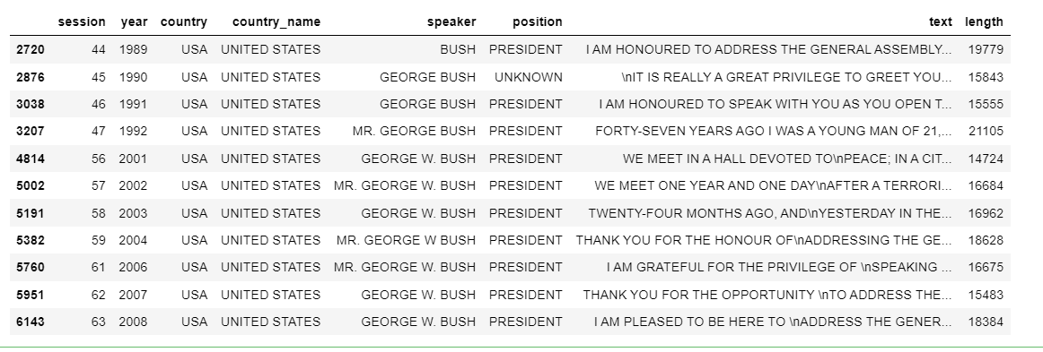
Problem with text:
Speakers with ‘BUSH’ in them:
df[df['speaker'].str.contains('BUSH')]

Slide 11
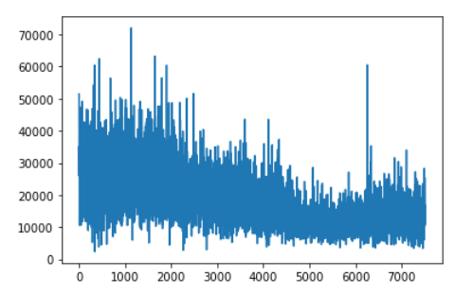
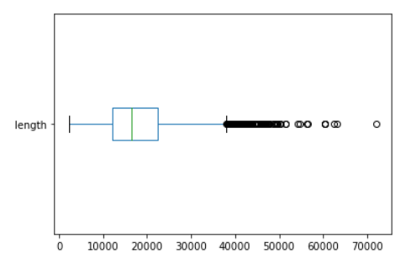
Now some charts!
df['length'].plot()
df['length'].plot(kind='box', vert=False)

Slide 12
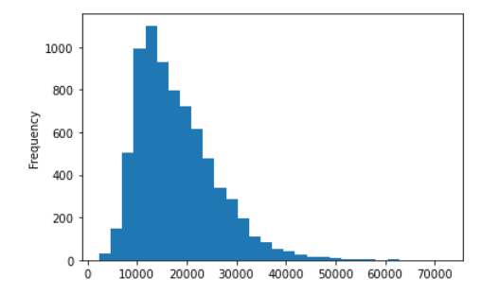
Histogram:
df['length'].plot(kind='hist', bins=30)

Slide 13
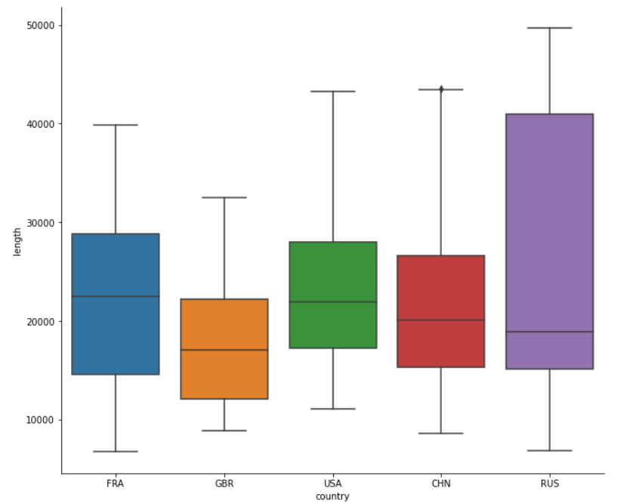
Bar plot:
import seaborn as sns
where = df['country'].isin(['USA', 'FRA', 'GBR', 'CHN', 'RUS'])
g = sns.catplot(data=df[where], x="country", y="length", kind='box')
g.fig.set_size_inches(10, 8) ###

Slide 14
Pre-processing pipeline:
1. Case folding (All uppercase or All lowercase)
2. Tokenization ( cut text into smaller parts, throw away unwanted stuff)
3. Stop word removal (at, and, if,….)
A sub-topic: Regular Expressions
https://regexone.com/

Slide 15
A famous regex to pull out words:
[\w-]*[a-z|A-Z][\w-]*
What?
A word is at least one alphabet (blue part) with maybe other letters or hyphens before or after it (yellow part)
A word
Hid word
.4 Not a word (you need at least one char)
D2.3 Word
Half-wit Word
Let’s TWO separate words “Let” and “s”
www.abc.com THREE separate words “www” , “abc”, “com”

Slide 16
Function to tokenize:
import regex as re
def tokenize(text):
return re.findall(r'[\w-]*[a-z|A-Z][\w-]*', text)
Let’s try it out before running it on the whole dataset.
testtext = "Let's defeat SARS-CoV-2 together in 2020! www.cdc.gov"
testtokens = tokenize(testtext)
print(testtokens)

Slide 17
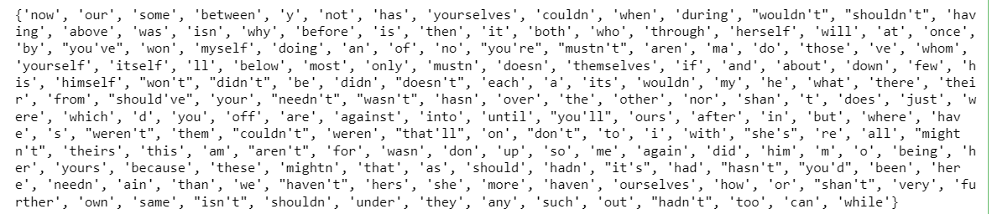
How to remove stop words?
We will use the list of English stop words that are standard in python or you can import a particular one.
import nltk
nltk.download('stopwords')
stopwords = set(nltk.corpus.stopwords.words('english'))
print(stopwords)

Slide 18
Function to remove stop words:
def remove_stop(tokens):
return [t for t in tokens if t.lower() not in stopwords]
#Just testing it
cleantokens= remove_stop(testtokens)
print(cleantokens)

Slide 19
Let’s make a “pipeline”
pipeline = [str.lower, tokenize, remove_stop]
def prepare(text, pipeline):
tokens = text
for fun in pipeline:
tokens = fun(tokens)
return tokens

Slide 20
Run the pipeline
df['tokens'] = df['text'].apply(prepare, pipeline=pipeline)
Takes time, wait a few minutes

Slide 21
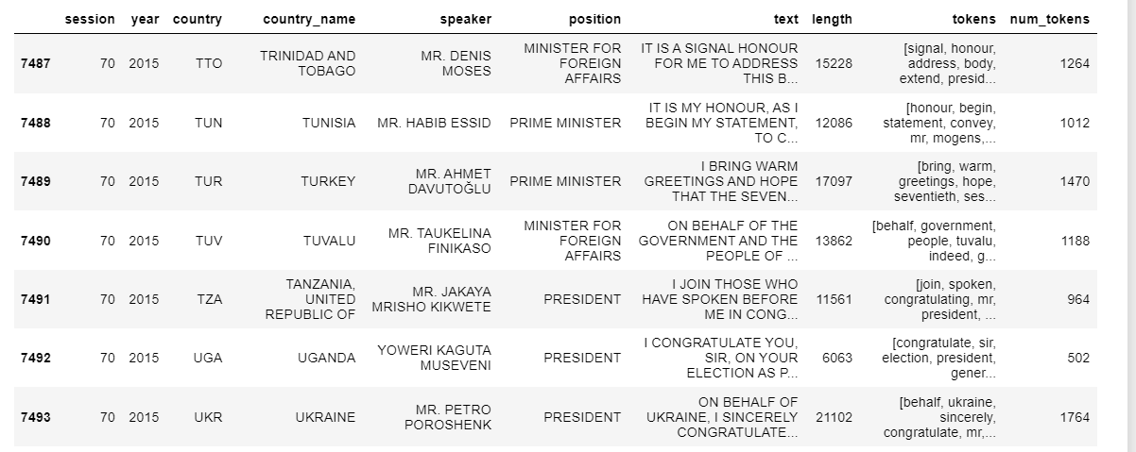
Count the tokens
df['num_tokens'] = df['tokens'].map(len)
df.tail()

Slide 22
Word Frequency Analysis
Easy! Use the “Counter”
from collections import Counter
tokens = tokenize("She likes my cats and my cats like my sofa.")
testcount= Counter(tokens)
print(testcount)

Slide 23
Let’s count:
counter = Counter()
df['tokens'].map(counter.update)
print(counter.most_common(5))

Slide 24
Now, we put the word frequency in it’s own dataframe for analysis:
freq_df = pd.DataFrame.from_dict(counter, orient='index', columns=['freq'])
freq_df = freq_df.query('freq >= 1')
freq_df.index.name = 'token'
You can use this to ignore words that appear very infrequently

Slide 25
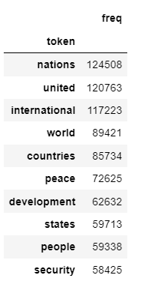
Sort and display!
freq_df = freq_df.sort_values('freq', ascending=False)
freq_df.head(10)
Very general words!

Slide 26

My style ☺ (ALL data)
wc = WordCloud(background_color='white', width = 300, height=300, max_words=100, margin=2)
wc.fit_words(freq_df['freq'].to_dict() )
plt.figure(figsize = (8, 8), facecolor = None)
plt.imshow(wc)
plt.axis("off")
plt.tight_layout(pad = 0)
plt.show()

Slide 27
Thank you!
Nikshep A Kulli

